Slide 1

No more admins
Using delegated rights and JEA
Jaap Brasser
@Jaap_Brasser

Slide 2

About_Jaap
Dutch PowerShell User Group (!!!)
Blogging
PowerShell Magazine
JaapBrasser.com
Slack
Reddit
GitHub
PowerShell Gallery
TechNet Forums/Gallery
@Jaap_Brasser

Slide 3
Agenda
Download and install JEA module
Explain different components of JEA
Setup JEA endpoints
Set permissions on session endpoints

Slide 4
PowerShell Endpoints
Available in PowerShell since 2.0
Allows for delegation
Default endpoints
microsoft.powershell
microsoft.powershell.workflow
microsoft.powershell32

Slide 5
PowerShell Language Modes
Different language modes
FullLanguage
ConstrainedLanguage
RestrictedLanguage
NoLanguage
Determines what the console can do

Slide 6
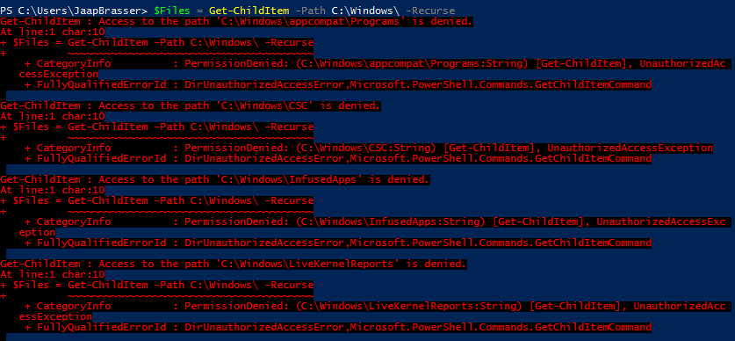
Demo1 – Create endpoints

Slide 7
Demo Summary
Created two endpoints
Viewed the resources used
View the generated start up script
View SDDL

Slide 8
Demo2 – Connect JEA endpoint

Slide 9
Demo Summary
Connect to a JEA endpoint
View the output
What is retricted in the languagemode

Slide 10
Demo3 – Edit JEA Configuration

Slide 11
Demo Summary
Use a non-administrative user
Configure single user SDDL
Change the start up script
Can be used to set own defaults

Slide 12
Demo4 – Uses for JEA

Slide 13
Demo Summary
Use JEA endpoint for GUI apps
Use JEA endpoint in scripts

Slide 14
What is next?
Forwarding event logs
Store transcripts securely
Lock down unneccesary services
Upgrade (!) to server core

Slide 15
Questions?

